Slide 1
Refresher in Python
Jeff Haltom

Slide 2
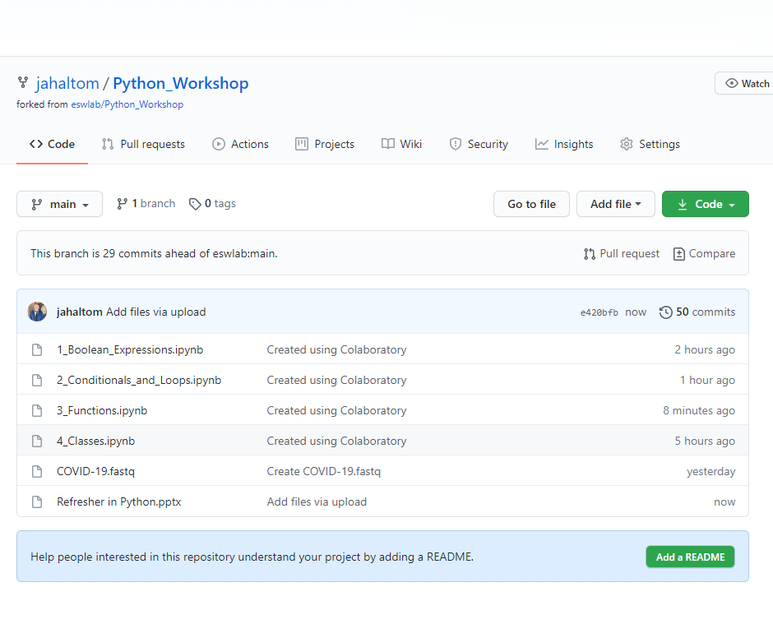
Stuff you will need
We will be working in Google Colab for this workshop. This is where the content is, and where our python code will be executed.
You must have a Gmail account to access Google Colab
All lesson material is on GitHub
https://github.com/jahaltom/Python_Workshop
Start by going to 1_Boolean_Expressions.ipynb
Lessons
File needed for lessons 3-4

Slide 3
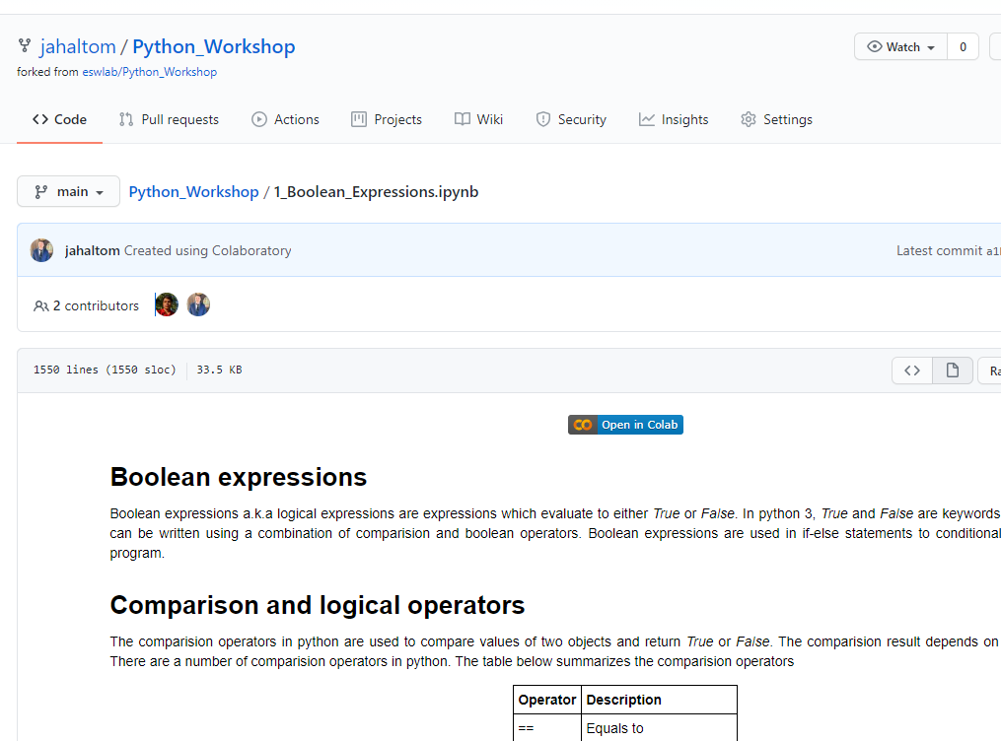
Getting to the Colab
From GitHub, you can get into Colab using the directions below. Once you are in Colab, this becomes your copy and you are free to write in it. Any changes you make can be saved to your google drive.
Once you are in 1_Boolean_Expressions in GitHub, click “Open in Colab”.

Slide 4
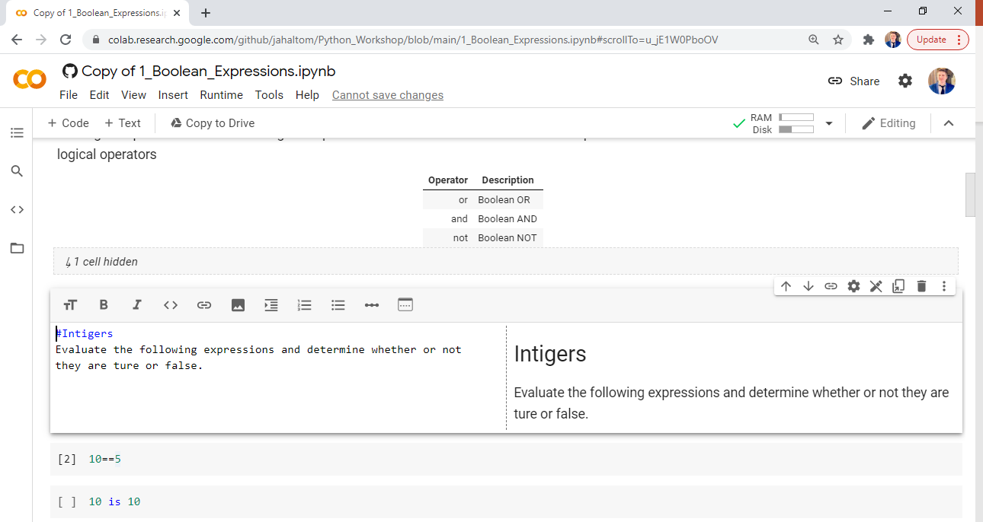
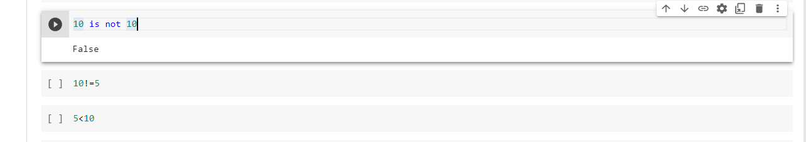
The Colab
Colab: is a platform that allows anybody to write and execute python code through their web browser. Colab consist of two parts, Text blocks and Code blocks.
Text blocks are readable and writable to the user and in this case is used to explain the workshop contents to you. You could also use this to take notes. To edit the prewritten text, you must double click on the text block. You can also add a new text block by pressing the “+ Text” button in Colab.
Code blocks are python code environments and are also readable and writable to the user as well as executable. To edit the prewritten code, you must double click on the code block. You can also add a new text block by pressing the “+ Code” button in Colab.
To execute a code block, click the “play” button. The output of the code is then shown below.
Once executed, you can clear the code output by pressing “Clear output” in on the far right. You may also just click play again and the new output will override the old.

